Slide 1
Dynamic Programming

Slide 2
Introduction
Dynamic programming approach is similar to divide and conquer in breaking down the problem into smaller and yet smaller possible sub-problems.
But unlike, divide and conquer, these sub-problems are not solved independently.
Rather, results of these smaller sub-problems are remembered and used for similar or overlapping sub-problems.

Slide 3
Dynamic programming is used where we have problems, which can be divided into similar sub-problems, so that their results can be re-used.
Mostly, these algorithms are used for optimization. Before solving the in-hand sub-problem, dynamic algorithm will try to examine the results of the previously solved sub-problems.
The solutions of sub-problems are combined in order to achieve the best solution.

Slide 4
So,
The problem should be able to be divided into smaller overlapping sub-problem.
An optimum solution can be achieved by using an optimum solution of smaller sub-problems.
Dynamic algorithms use Memorization.

Slide 5
Comparison
In contrast to divide and conquer algorithms, where solutions are combined to achieve an overall solution, dynamic algorithms use the output of a smaller sub-problem and then try to optimize a bigger sub-problem.
In contrast to greedy algorithms, where local optimization is addressed, dynamic algorithms are motivated for an overall optimization of the problem.
Dynamic algorithms use Memorization to remember the output of already solved sub-problems.

Slide 6
Example
The following computer problems can be solved using dynamic programming approach −
Fibonacci number series
Knapsack problem
Tower of Hanoi
All pair shortest path by Floyd-Warshall
Shortest path by Dijkstra
Project scheduling

Slide 7
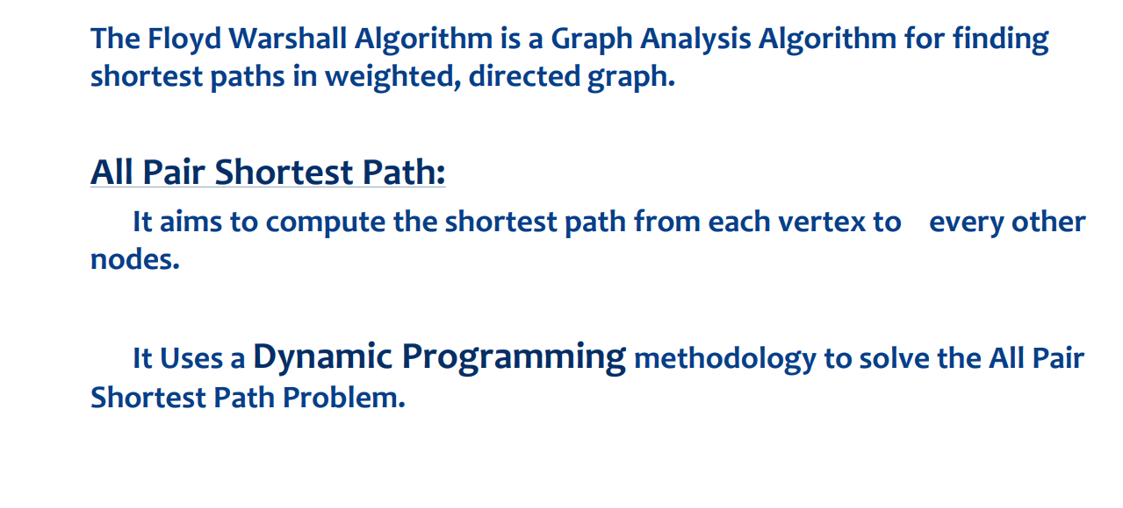
Floyd Warshall Algorithm

Slide 9
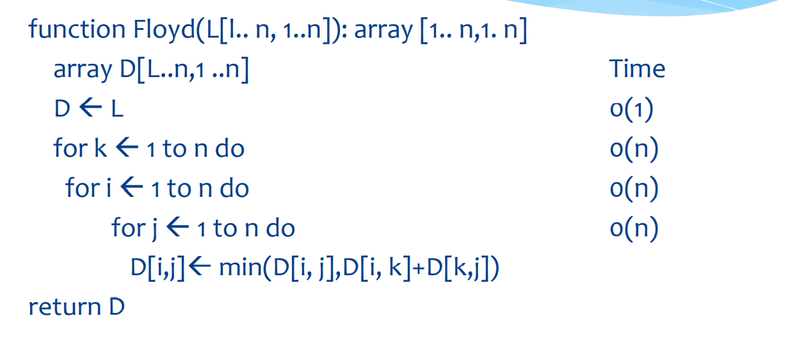

Slide 10
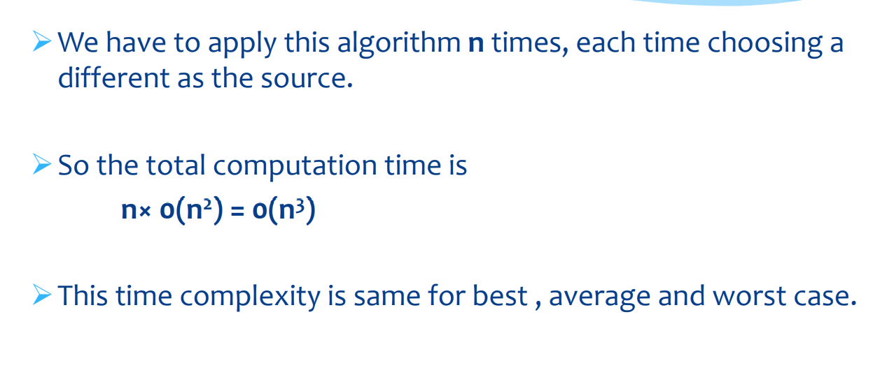

Slide 11
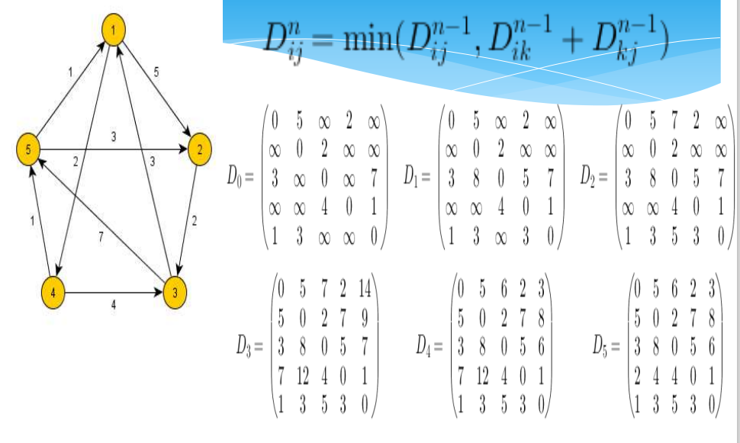

Slide 12
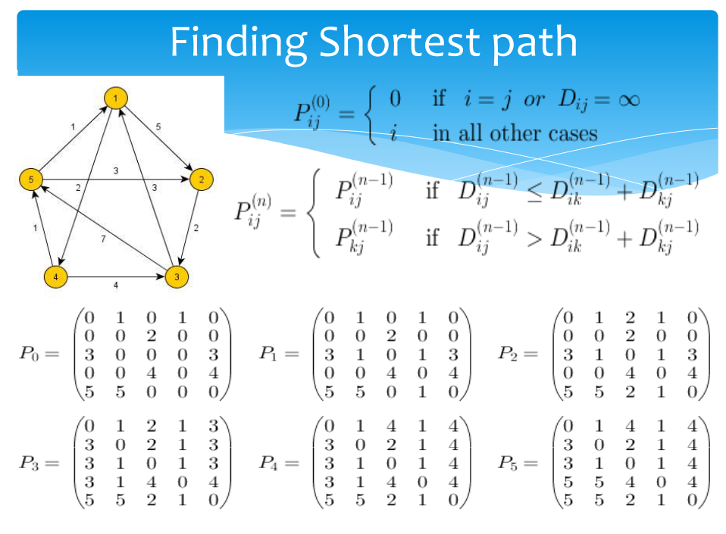

Slide 13
